Slide 1
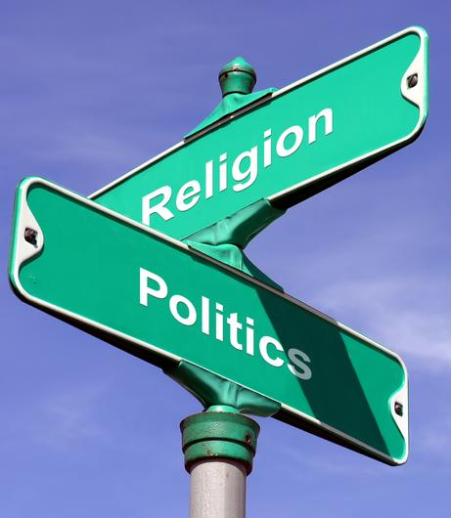
Religion and the 2016 Presidential Election
James B. Bennett
Santa Clara University

Slide 2
Religion and the 2016 Presidential Election
Religious Identity of the Candidates
Religious Identity of Voters
Recent Developments &Religious Issues

Slide 3
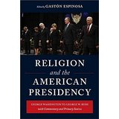
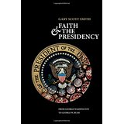
The Candidate’s Faith

Slide 4
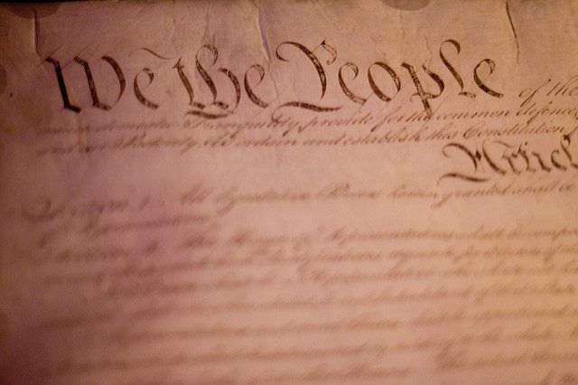
The Candidate’s Faith
“no religious test shall ever be required as a Qualification to any office or public trust under the United States.”
U.S. Constitution, (Article VI, section 3)

Slide 5
The Candidate’s Faith

Slide 6
The Candidate’s Faith

Slide 7
The Candidate’s Faith

Slide 8
The Candidate’s Faith
Park Ridge United Methodist Church
The Rev. Don Jones

Slide 9
The Candidate’s Faith
Foundry United Methodist Church, Washington, D.C.

Slide 10
The Candidate’s Faith

Slide 11
The Candidate’s Faith

Slide 12
The Faith of the Voters
Changing Demographics
Voting by Religious Tradition
2016 Trends

Slide 13
The Faith of the Voters: Changing Demographics

Slide 14
The Faith of the Voters: Changing Demographics

Slide 15
The Faith of the Voters: Changing Demographics
Catholics in America
31.7% of American adults were raised Catholic
41% of these no longer identify with Catholicism
Meaning 12.9% of Americans are former Catholics
Only 2% of Americans have converted to Catholicism from another religious tradition
Most lopsided ratio of losses to gains in US

Slide 16
The Faith of the Voters: Changing Demographics

Slide 17
The Faith of the Voters: Changing Demographics
The Rise of the Nones
+9%
(25% of total)
+6%
22% of total
+6%
(19% of total)
+7%
(28% of total)

Slide 18
The Faith of the Voters: Changing Demographics

Slide 19
The Faith of the Voters: Voting Patterns by Affiliation

Slide 20
The Faith of the Voters: Voting Patterns by Affiliation
Evangelicals and Republicans

Slide 21
The Faith of the Voters: 2016 Trends

Slide 22
The Faith of the Voters: 2016 Trends

Slide 23
The Faith of the Voters: 2016 Trends
Nones

Slide 24
The Faith of the Voters: 2016 Trends
“Donald Trump has a Massive Catholic Problem”
The Washington Post
August 30, 2016

Slide 25
The Faith of the Voters: 2016 Trends
Closing the God Gap:

Slide 26
The Faith of the Voters: 2016 Trends

Slide 27
The Faith of the Voters: 2016 Trends

Slide 28
Religion and the 2016 Presidential Election
pewforum.org
Key Sources
prri.org

Slide 29
Religion and the 2016 Presidential Election
James B. Bennett
Santa Clara University

